Slide 1
“Pieces of the Mystery”
Important Note:
If you can see this box, then the slide show is not playing and the reveal won’t work.
Here is the solution:
If you are using PowerPoint, click on Slide Show, then click on From Current Slide.
If you are using Google Slides, click on View then Present.
Steve Wyborney
www.stevewyborney.com

Slide 2
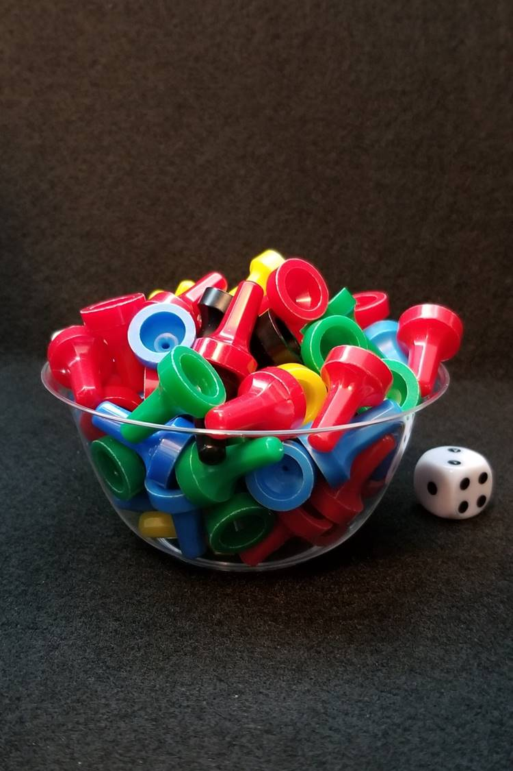
How many game pieces are there?
As the clues appear, use the information to narrow the possibilities to a smaller set. After each clue, use estimation again to determine which of the remaining answers is the most reasonable.
Write down your first estimate. After each clue, you’ll see if your estimate is still a possibility. After each clue, if it is no longer possible write down a new estimate – and be prepared to explain why you chose it.
Steve Wyborney
www.stevewyborney.com

Slide 3
Clue #1
Clue #1
The answer is an even number between 40 and 90.
Clue #2
Clue #2
The answer is not a multiple of 4.
Clue #3
Clue #3
The answer does not include the digit 0 or the digit 4.
Clue #4
Clue #4
Double 39 and then
eliminate that number.
Clue #5
Clue #5
The answer does not include
the digit 6
Steve Wyborney
www.stevewyborney.com

Slide 4
After seeing the clues, you have narrowed the possibilities to a small set of numbers. Before you see the answer, select your final estimate. Write it down, and explain to someone why you chose that number.
Steve Wyborney
www.stevewyborney.com

Slide 5
82 pieces
The Reveal
Click to see the answer.
Important Note:
If you can see this box, then the slide show is not playing and the reveal won’t work.
Here is the solution:
If you are using PowerPoint, click on Slide Show, then click on From Beginning.
If you are using Google Slides, click on View then Present.
Steve Wyborney
www.stevewyborney.com

Slide 6
New Esti-Mysteries and Number Sense Resources Every Day for the Rest of the School Year
More Free, Downloadable Resources From Blog Posts
51 Esti-Mysteries
The Original
50 Splat! Lessons
The Original
20 Fraction
Splat! Lessons
The Original 40 Estimation Clipboard Sets
80 Cube Conversations
Lessons
20 Days of
Number Sense
& Rich Math Talk
To Access The Multiplication Course…
Click here to see the chapter playlists on my YouTube channel.
Click on “sort by” (on the right side) and choose Date created (oldest)
You’ll see all 12 chapters in the course.
Tips for Using the Multiplication Course
When looking at playlists, click on the words “View Full Playlist” instead of the thumbnail or the chapter title.
Then click on the share button.
Copy the link and send it to your class.
Begin with 1 lesson (1 video) per day and then adjust the pacing to meet the needs of your class.
For more information read the blog post about The Multiplication Course here.

